Slide 1
Chapter 1: Introduction to Statistics(part 2):
Variable & Data

Slide 2
Learning Outcomes
After completing this chapter, you will be able to-
Understand about data.
Identify several types of variables with their levels to store data in.

Slide 3
Contents
From this lecture, you are going to learn…
Variable and types of variable
Data and types of data
Levels of measurements
Applications Of Statistics In Engineering

Slide 4
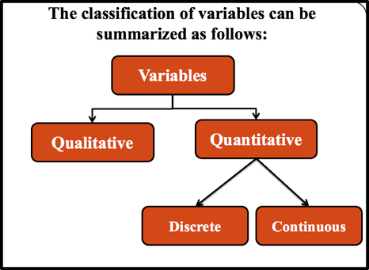


Variable & Types
Variable : Any characteristic which may vary either in magnitude or in quality is called variable.
Your height:?
No. of Family members: ?

Slide 5




Types of Quantitative variable
Qualitative or attribute variable: Numerical measurement is not possible and may have several mutually exclusive categories.
Quantitative variable: Numerical measurement is possible.
What is your Height?
No of cars passing a road per minutes.
Where is your Home District?
Your Religion?
Muslim
Hindu
Christian
Others

Slide 6


Types of Quantitative variable
Discrete variable: Assume isolated values which are countable.
Continuous variable: Assume any value within a specified range.
No. of sibling in your family
Your Blood Pressure
Example: The number of students in 20 classes, number of cars passing a certain road per minute (1, 2, 3, etc).
Example: The distance of students home from University, Temperature etc.

Slide 7
Data and Types
Data are numerical facts and figures collected from any field of investigation.
Obtained by Direct observation. Some methods to collect primary data are Observation method
Interview method
Through questionnaires etc.
Primary Data
Data
Obtained from published or utilized data. Secondary data can be collected from publications newspapers, reports etc.
Secondary Data

Slide 8
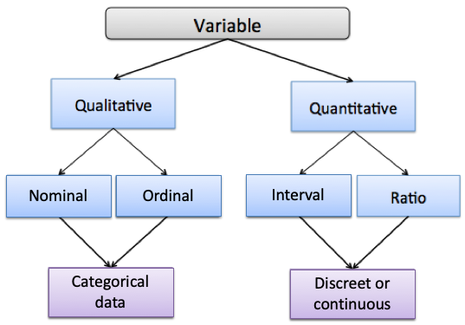
Types of variables with Level
So, there are four levels of measurements:
1. Nominal level data.
2. Ordinal level data
3. Interval level data
4. Ratio level data.
1. Categorical Data
Discrete Data or
Continuous Data

Slide 9



Types of variables with Level
Nominal level: data that is classified into categories and cannot be arranged in any Particular order.
Ordinal level: involves data arranged in some order, but the differences between data values cannot be determined or are meaningless.
Where is your Home District?
Your Religion?
Muslim
Hindu
Christian
Others
Exam Grade.
Position in a competition etc
Phone no., Blood group etc

Slide 10
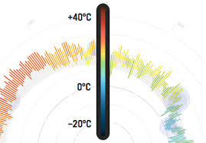

Types of variables with Level
Interval level: Numerical measurement is possible with meaningful amount of differences between data values. There is no natural zero point. (meaningless zero).
Ratio level: Numerical measurement is possible with meaningful amount of differences between data values and natural zero point. (meaningful zero).
Temperature
Required time to solve a math.

Slide 11
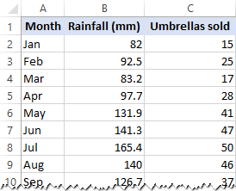
Data and Variables
at a glance…
Qualitative or attribute variable
(Nominal)
Quantitative
variable
(continuous)
(Ratio)
Quantitative
variable
(Discrete)
(Ratio)
Data

Slide 12
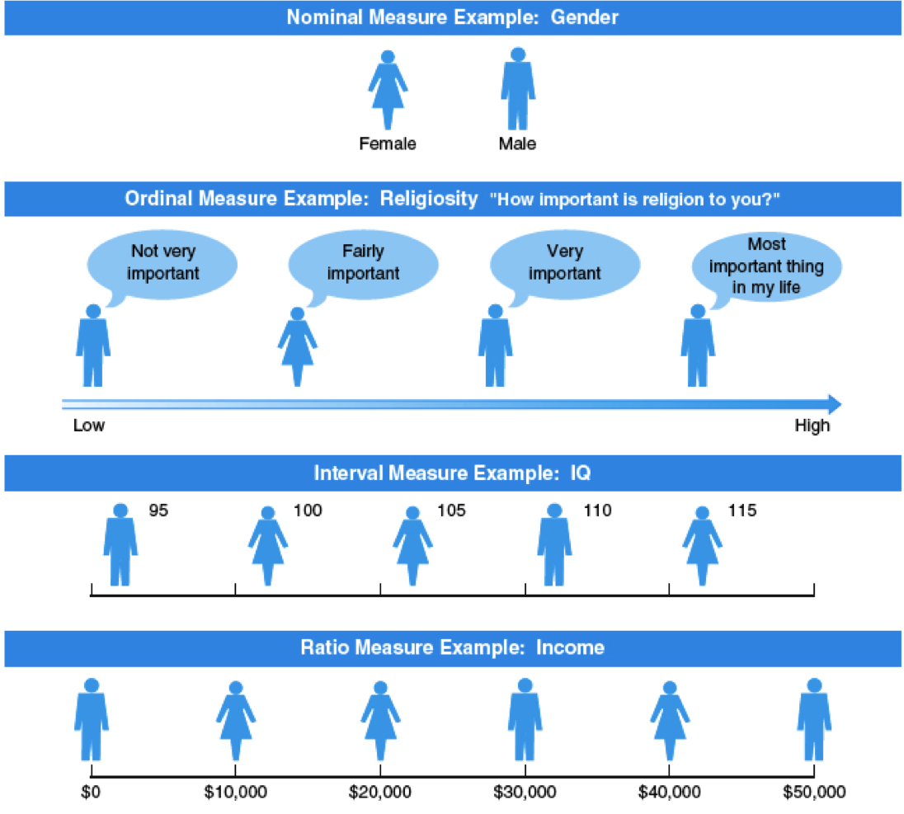
Types of variables with Level

Slide 13
CLASS EXERCISE
Classify the following as quantitative (discrete or continuous) or qualitative. Also mention the levels:
Color of the eye
Number of typewriters in a room
Address
Telephone numbers
Rank of students
Speed of a car
Birth rates
Score in mathematics examination

Slide 14
CLASS EXERCISE
Identify each of the following as continuous or discrete also find there levels:
Weight for airlines baggage
Length of arc
Number of patients in each of the rooms of a hospital.
Number of passengers in a plane
Amount of sales in a business firm
Speed of light
Area of a land
Lifetime of television tubes and batteries
Life span of a person.

Slide 15
Why Study Statistics in Engineering?
Application of Statistics in Engineering:
Simulation is based on the statistical description of the behavior of objects
Many machine learning algorithms are basically applied statistics
Any kind of prediction usually uses some statistics (weather, stocks, …)
Item Response Theory is a computational/statistical technique used to grade answers to tests, such as GRE and GMAT.
If you work in an SQA (Software Quality Assurance) team, Good SQA teams use statistical analysis techniques to analyze such things as defect (bug) trends, arrival rates, resolution rates, density etc; test scripts code coverage, data coverage etc.

Slide 16
Why Study Statistics in Engineering?
Application of Statistics in Engineering:
NETFLIX, Facebook, YouTube and many other platforms use Statistics to predict what show we might to watch next.
Researchers from any field use Statistics to make conclusions from the data based on their inquiry.
Now a day Data mining, Data Science, Artificial Intelligence, Machine Learning are in great interest. All these great courses need the basic knowledge of Statistics to deal with the data.
There are some text retrieval algorithms based on probability and statistics
Many games use statistics for deciding if some events happen or not

Slide 17


